Slide 1
Quick icebreaker!
Sit in groups of three and introduce yourself. Please discuss the following:
Name
Major/Minor
Year
Favorite class taken so far
Something interesting about you

Slide 2
Chapter 1: The Ecosystem Concept
Principles of Terrestrial Ecosystem Ecology
January 22, 2025

Slide 3
What is ecosystem ecology?

Slide 4
What is ecosystem ecology?
The study of relationships between organisms and:
(1) Each other
(2) The environment

Slide 5
What is ecosystem ecology?
The study of relationships between organisms and:
(1) Each other (the biotic environment)
(2) The environment (the abiotic environment)

Slide 6
What aspects of the abiotic and biotic environment influence organismal functioning?

Slide 7
What aspects of the abiotic and biotic environment influence organismal functioning?
Pick an organism (human, microbe, dog, etc.) and list a few abiotic and biotic factors that might influence how that organism functions in an environment

Slide 8
Hierarchy of Ecology
Physiological Ecology
Population Ecology
Community Ecology
Ecosystem Ecology
Spatiotemporal
scale

Slide 9
What is ecosystem ecology?
A system that includes all interactions among and between organisms and their environment.

Slide 10
What are some examples of ecosystems?

Slide 11
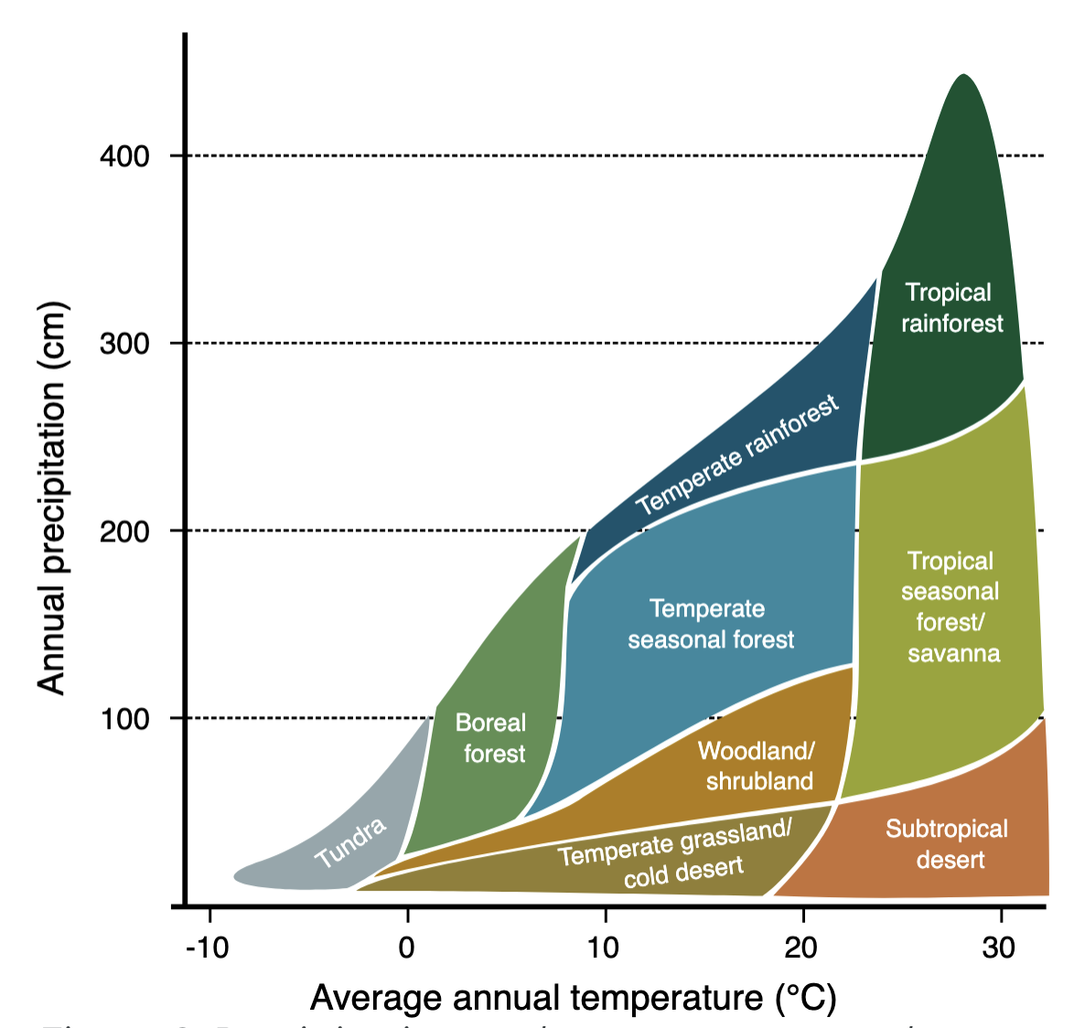

Slide 12
Ecosystem ecology is the study of the interactions between organisms and their environment as an integrated system

Slide 13
Ecosystem ecology is a game of pools and fluxes
Ecosystem ecologists seek to understand factors that regulate pools and fluxes of materials and energy through ecological systems
Pools – quantities of a given material/energy (e.g., carbon, water, nitrogen)
Fluxes – flows of a given material/energy (e.g., photosynthesis, respiration)
Ecosystem processes describe the transfer of energy and materials from one pool to another (i.e., a flux)

Slide 14
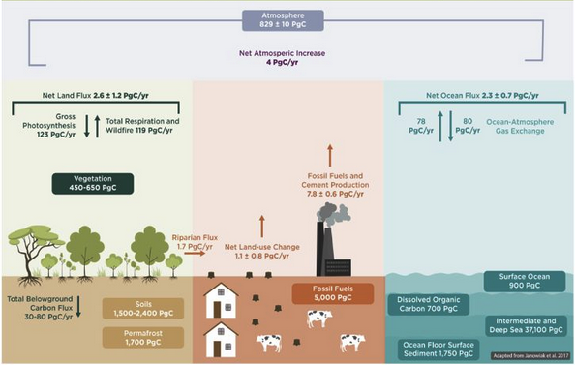
https://www.canr.msu.edu/news/carbon-fluxes-and-carbon-stocks

Slide 15
Ecosystem ecology seeks to answer questions like:
Why do tropical forests have large trees but accumulate only a thin layer of dead leaves at the soil surface, while the tundra supports small plants but an abundance of organic matter at the soil surface?
Why does the concentration of carbon dioxide in the atmosphere decrease in the summer and increase in the winter?
What happens to nitrogen fertilizer that farmers add to their fields but do not harvest with the crop?
Notes:
Answers to these questions require an understanding of the interactions between organisms and their physical environments
They also require a focus on integrated ecological systems rather than individual organisms or physical components

Slide 16
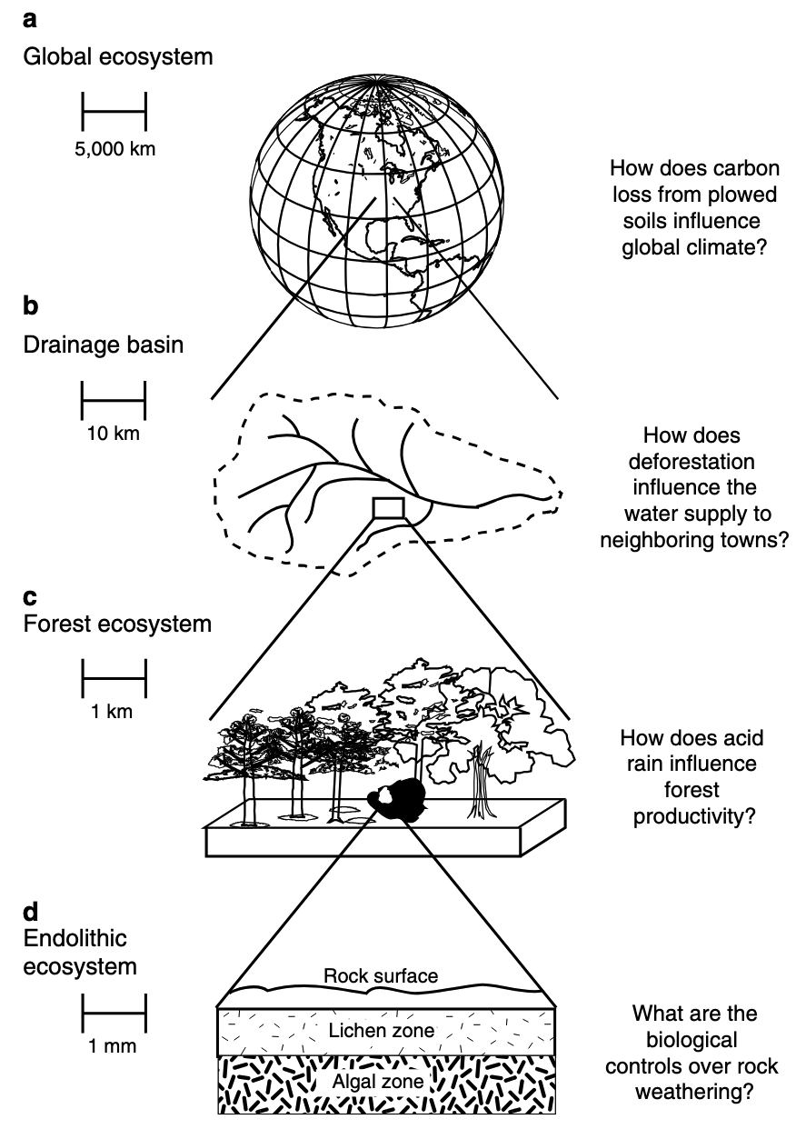
Ecosystem processes can be studied at many spatial scales
Scale is very important when considering certain questions in ecosystem ecology!

Slide 17
What are some examples of ecosystem processes? What scale might these processes be measured?

Slide 18
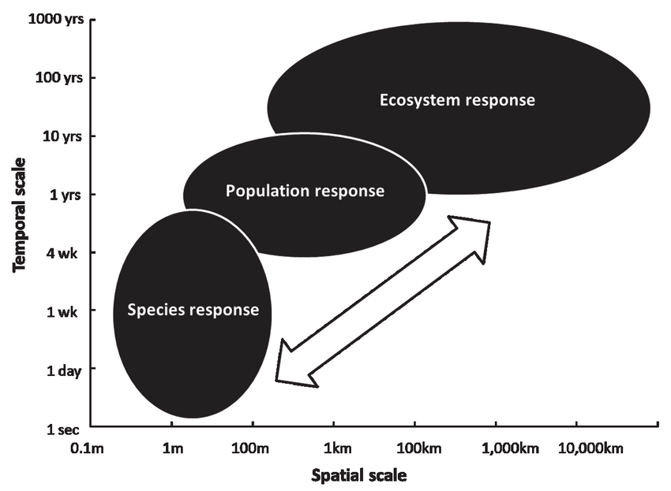
Ecosystem processes are an emergent property product of different ecological hierarchies

Slide 19
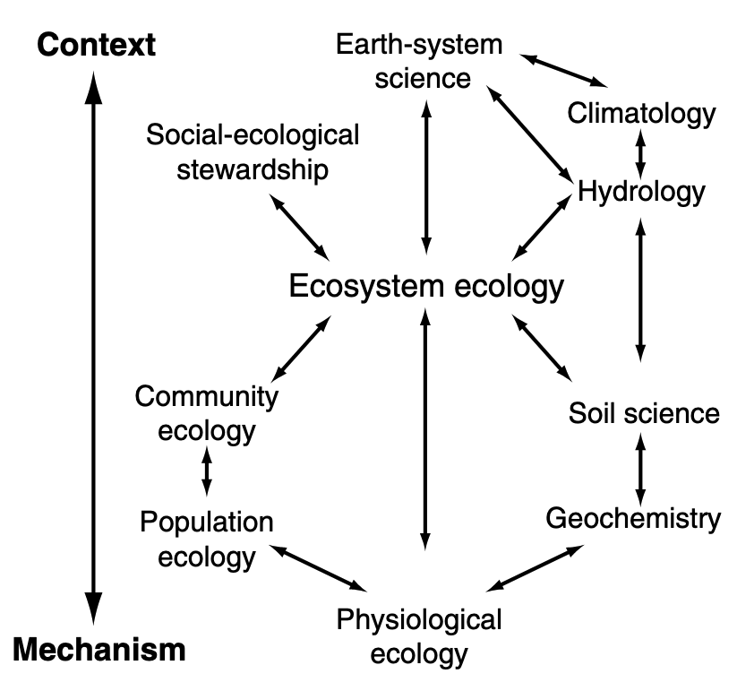
Given this, ecosystem ecology depends on information from physiological, population, and community ecology
It also integrates several other study disciplines, including those from social sciences!

Slide 20
Ecosystem processes are regulated by several state factors
Hans Jenny (US soil scientist) in 1941 first to formalize a quantitative model of soil formation as well as the “state factors” that set the bounds for characteristics of an ecosystem:
S = f (climate, organisms, relief/topography, parent material, time)

Slide 21
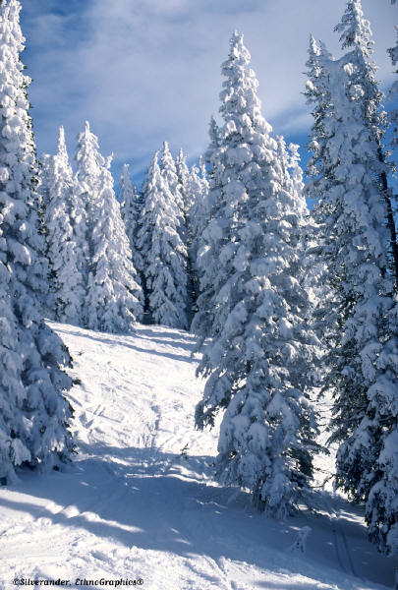
Cl
Climate
O
* Precipitation
* Temperature
R
P
T

Slide 22
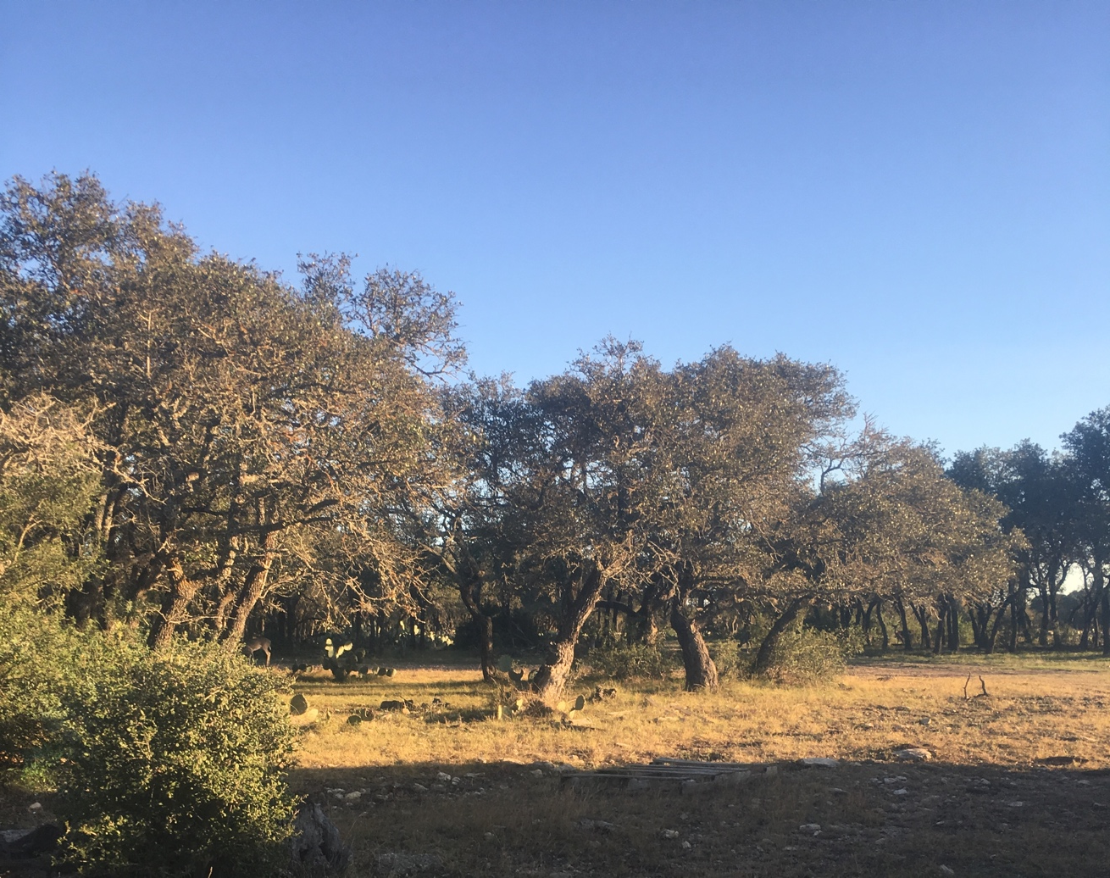
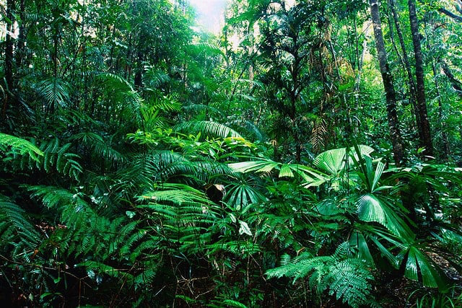
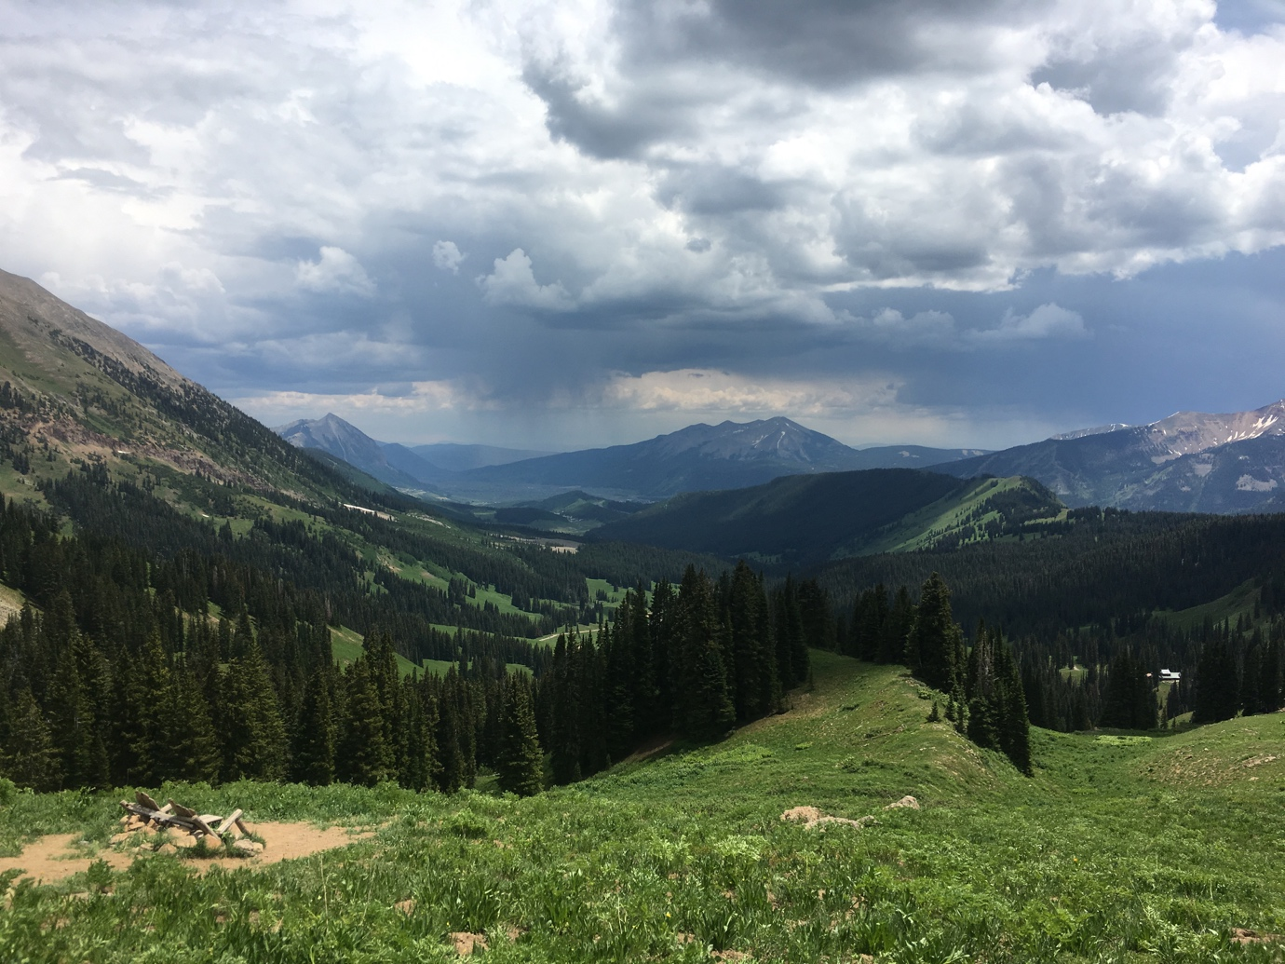
Climate
Wet --------- Dry

Slide 23
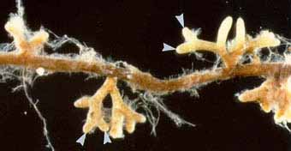
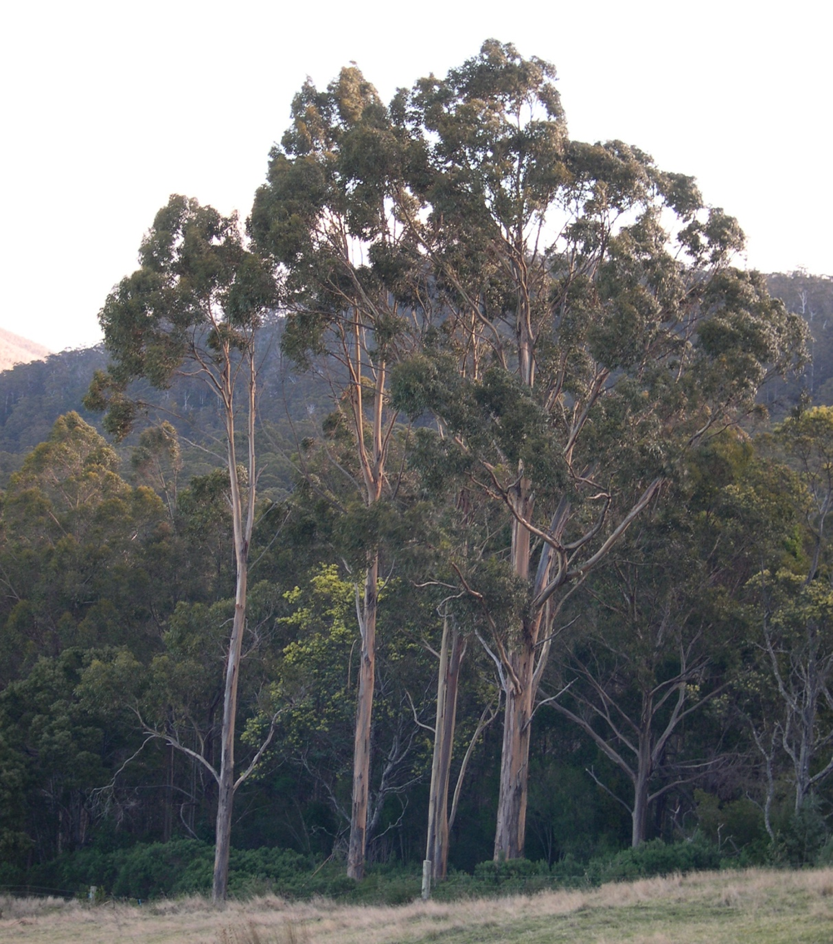
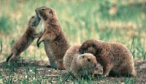
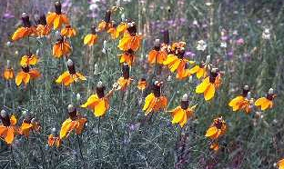
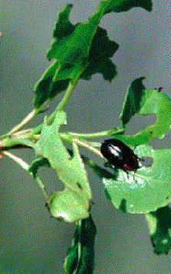
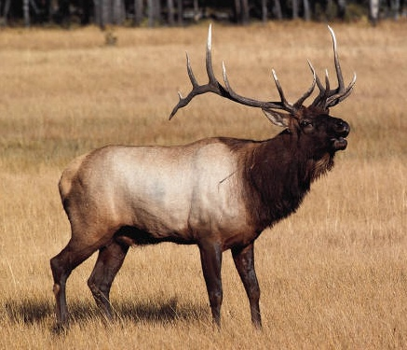
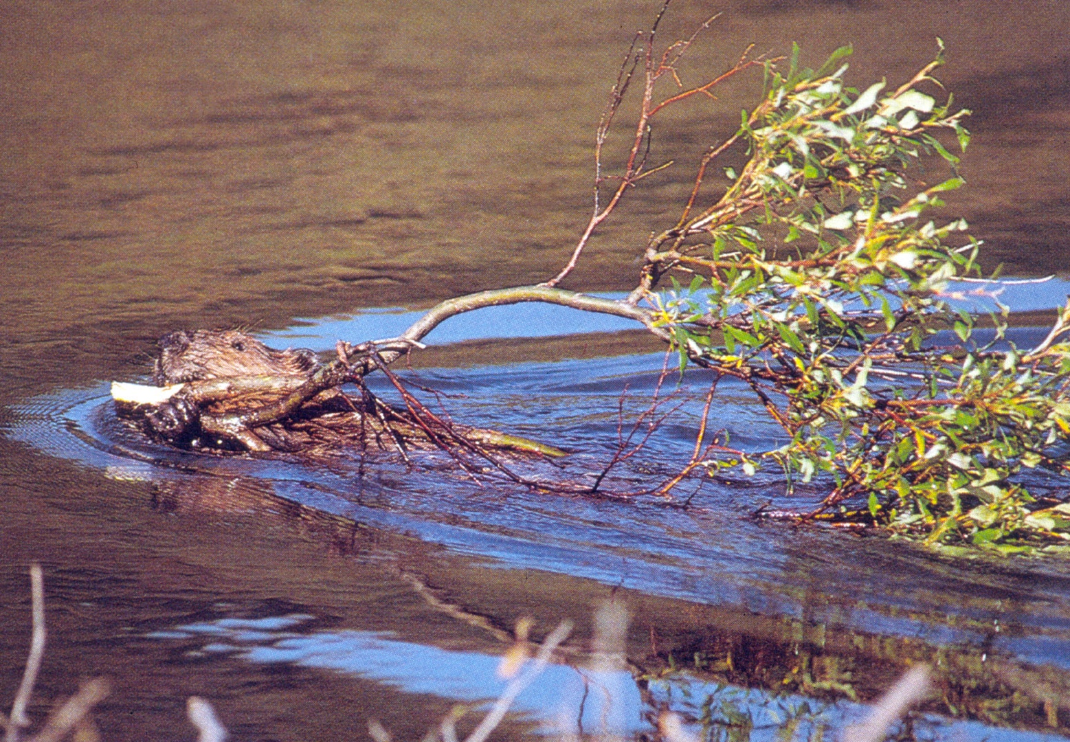
Cl
O
Organisms
R
P
T

Slide 24
Organisms
Diverse --------- Depauperate

Slide 25
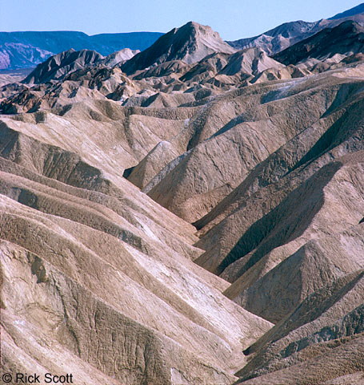
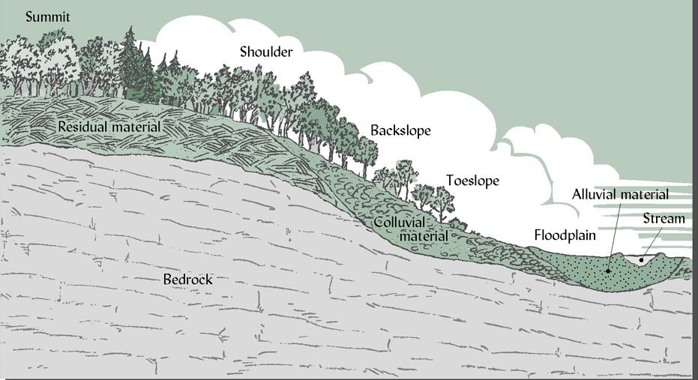
Cl
O
R
Relief/Topography
P
T

Slide 26
Topography
Steep --------- Flat

Slide 27
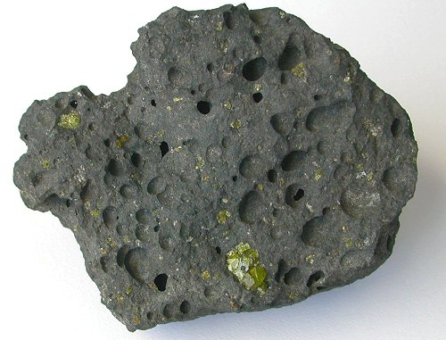
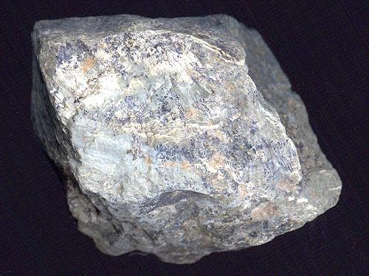
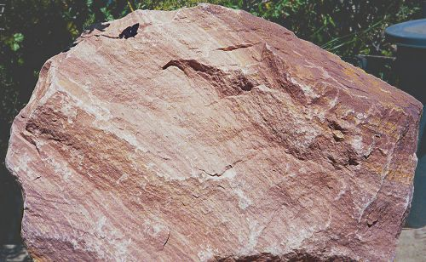
Cl
O
R
Igneous (basalt)
Metamorphic (schist)
P
Parent Material
T
Sedimentary (sandstone)

Slide 28
Parent Material
Igneous Sedimentary Basalt

Slide 29
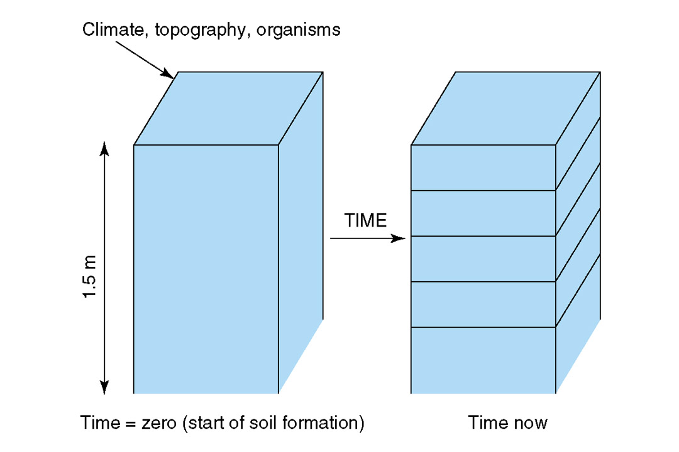
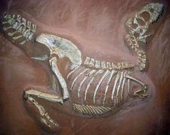
Cl
Development of Soil
O
R
Evolution
P
T
Time

Slide 30
Time
Old -------------- Recent

Slide 31
Example: succession is the result of state factor changes

Slide 32
Lake Michigan dunes

Slide 33
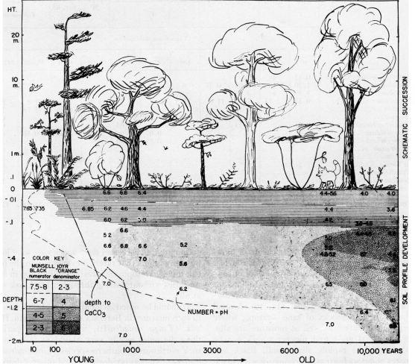
Lake Michigan dunes
Olson (1958)

Slide 34
Lake Michigan dunes
Beaches
Low nutrient environments
Unstable soils
Few plants (sea rocket)
Foredunes
Soil stabilized by grasses
Low nutrient soils
Grasses and wildflowers
Dune forests
Better soils
Competition is for light (tall plants)
Olson (1958)

Slide 35
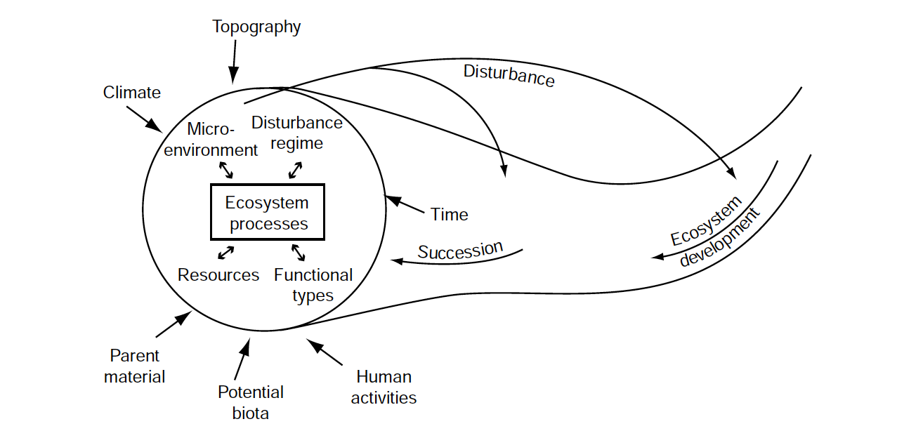
Ecosystem processes are driven by multiple interacting factors (including state factors)
In your book, but modified from Chapin et al. (2006)

Slide 36
Ecosystem services: “things an ecosystem provides”

Slide 37
What “services” do humans get from ecosystems?

Slide 38
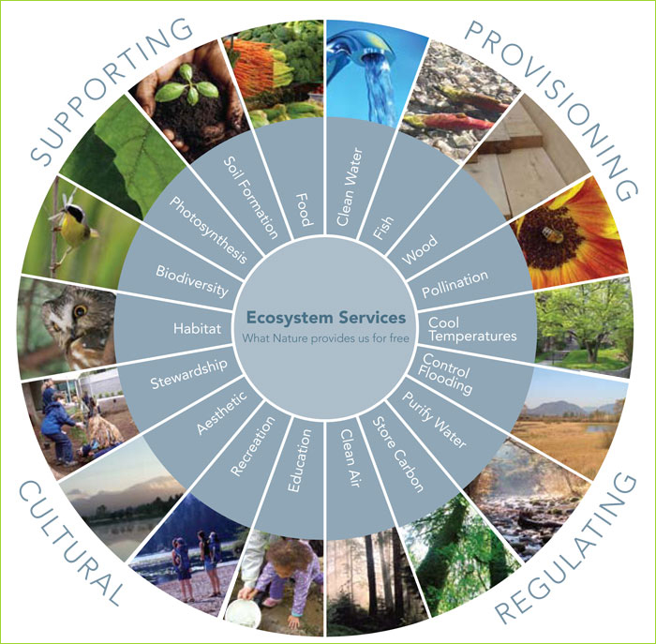
FNAL

Slide 39
Human Domination of Earth’s Ecosystems
Vitousek PM, Mooney HA, Lubchenco H, Melillo JM. 1997. Human domination of Earth’s ecosystems. Science 277(5325):494-499.

Slide 40
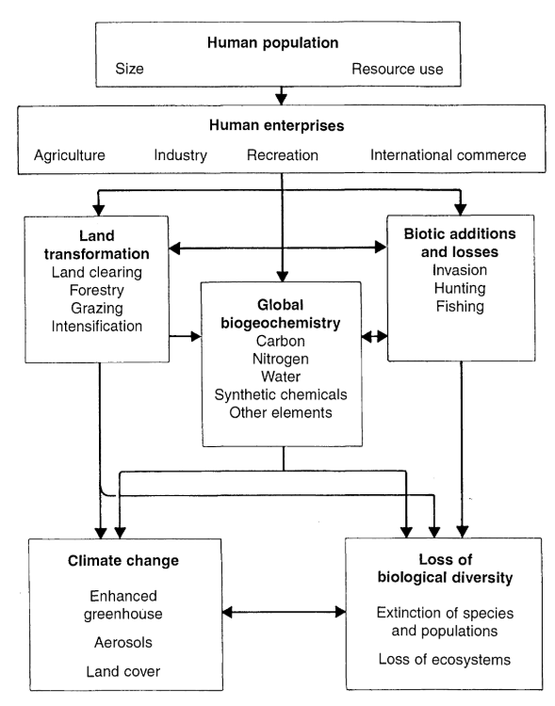
Humans have many direct and indirect effects on the Earth system

Slide 41
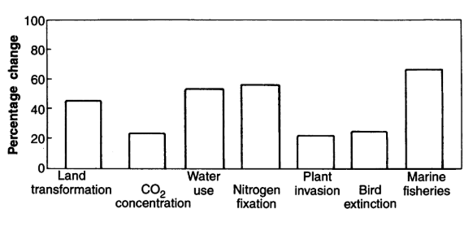
Humans have altered several major components of the Earth system

Slide 42
Humans have many direct and indirect effects on the Earth system

Slide 43
Land transformation
Nearly 50% of all land has been transformed by humans
Primary driver of species loss
20% of all CO₂ emissions
NASA
Border between Haiti (left) and Dominican Republic (right)

Slide 44
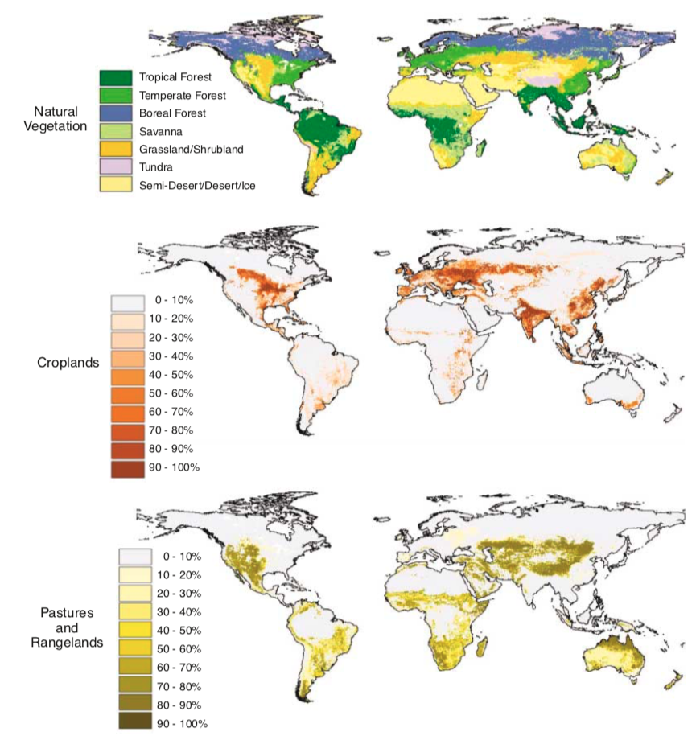
Foley et al. (2005)

Slide 45
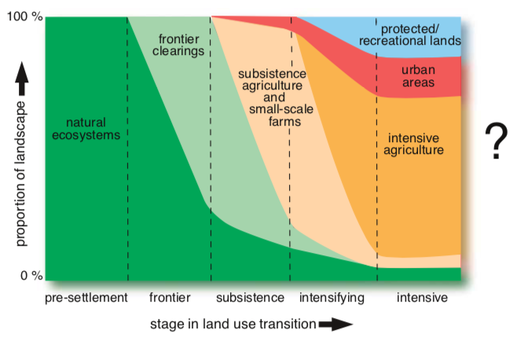
Progressive land transformation (Foley et al. 2005)

Slide 46
Humans have many direct and indirect effects on the Earth system

Slide 47
Biogeochemistry - Carbon
Humans emit 5,500,000 tons of carbon per year
Ecosystems take up only 2,300,000 tons per year
Impacts
Climate change
Ocean acidification
Decreased food quality

Slide 48
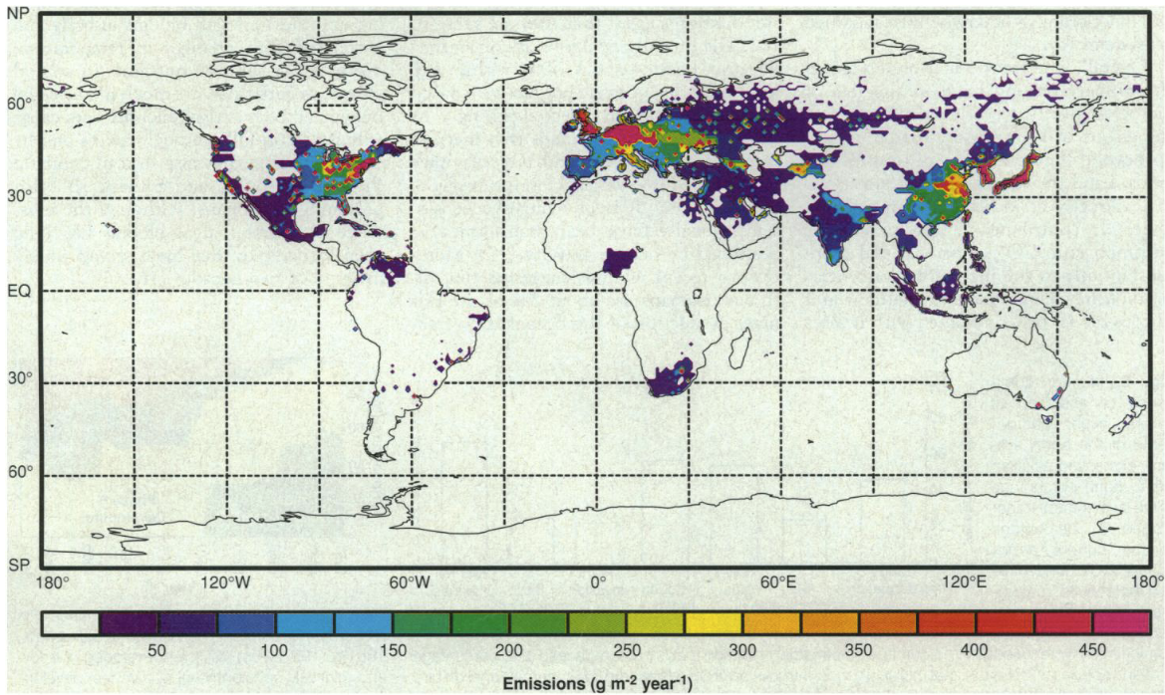
Geographical distribution of fossil fuel CO2 emissions is highly correlated with urban hubs

Slide 49
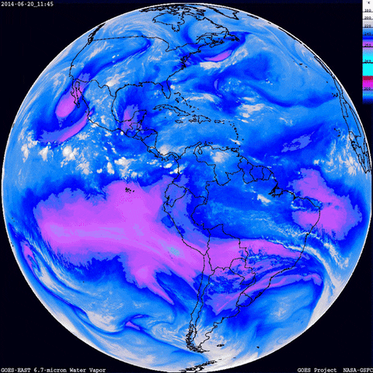
Biogeochemistry - Water
Humans use 50% of accessible freshwater
70% of that in agriculture!
Water travels long distances
Water use can impact climate locally and far away

Slide 50
Biogeochemistry - Nitrogen
Human activities add as much fixed N to terrestrial ecosystems as all natural sources combined!
Where does it come from?
N saturation – not all N can be taken up
Where does it go?
USDA

Slide 51
Humans have many direct and indirect effects on the Earth system

Slide 52
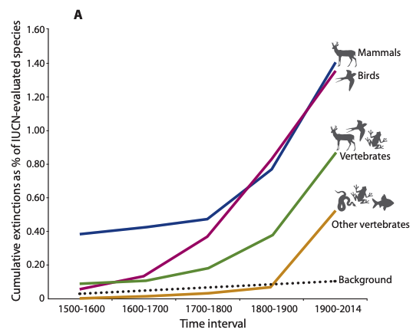
Biotic change – Species loss
Percent of extinct species
(note the background rate)
Ceballos et al. (2015)

Slide 53
Biotic Changes – Species Loss
The number of species increases with space
Pimm et al. (2014)

Slide 54
Biotic Changes - Invasion
Invasive species are threatening all across the globe.
What might explain these patterns?
Early et al. (2016)

Slide 55
Biotic Changes - Invasion
Early et al. (2016)

Slide 56
Biotic Changes - Invasion
Early et al. (2016)

